Slide 1



GRAPHICAL PASSWORD AUTHENTICATION
SRI KRISHNA ARTS AND SCIENCE COLLEGE
DEPARTMENT OF COMPUTER TECHNOLOGY & DATA SCIENCE
ACADEMIC YEAR 2024 – 25
COMPREHENSIVE PROJECT
FOR
COMPUTER STUDIES REPORT
Course Code : 23AEC53
Under the Guidance of
Ms. S. Srisowmiya, M.Sc., (Ph.D).,
Assistant Professor
Department of Computer Technology & Data Science
Submitted by
Monisha R - 23BCT135
Dharshan V N - 23BCT112
Jai Surya Anandhan - 23BCT121

Slide 2
GRAPHICAL PASSWORD AUTHENTICATION
SRI KRISHNA ARTS AND SCIENCE COLLEGE
DEPARTMENT OF COMPUTER TECHNOLOGY & DATA SCIENCE
ADGENDA
1. INTRODUCTION
2. PROBLEM STATEMENT
3. EXISTING SYSTEM
4. PROPOSED WORK
6. ADVANTAGES
5. TOOLS USED
6. WORKING OF THE SYSTEM
8. MODULE DESCRIPTION
9. PLAN FOR FUTURE ENHANCEMENT
10. CONCLUSION
11. OUTPUT SCREEN SHORT

Slide 3

GRAPHICAL PASSWORD AUTHENTICATION
SRI KRISHNA ARTS AND SCIENCE COLLEGE
DEPARTMENT OF COMPUTER TECHNOLOGY & DATA SCIENCE
INTRODUCTION:
WHAT ARE AUTHENTICATION METHODS?
Authentication is a method used to verify a user’s identity when the user is trying to access network resources.
Authentication method refers to verifying the identity of someone that maybe a user, a device or an entity who wants to access data resources or applications .
GRAPHICAL PASSWORD AUTHENTICATION OR PICTURE BASED AUTHENTICATION is a a form of authentication using images rather than letters digits or special characters .
It is developed to resolve the shoulder surfing problem .
GPA allows the user to set a pattern password for using the applications .

Slide 4
GRAPHICAL PASSWORD AUTHENTICATION
SRI KRISHNA ARTS AND SCIENCE COLLEGE
DEPARTMENT OF COMPUTER TECHNOLOGY & DATA SCIENCE
PROBLEM STATEMENT :
Computer Security is the processof protecting computers systems and it’s information from attack, theft and unauthorized use. Computer data is typically protected by the same means used to protect other valuable or sensitive equipment namely, serial numbers, doors and locks, and alarms. Data is the new oil in today’s world. Cybersecurity encompasses a broad range of practices, tools and ideas related closelyto those of information and operational technology (OT) security. Cybercrime is distinctive in its inclusion of the offensiveuse of data technology to attack adversaries. Authentication is one of the important security points where user has active responsibility for their personal information security. Graphical PasswordAuthentication is a method of authentication whichuses Graphical images instead of alphanumeric textual passwords and symbols. As the psychological studies supports the assumption that human brain can processwith images much better than text data. Another advantage is that images are easy for remembering. User interactions with the images vary on each implementation. It enables GPA to not require a huge amount of data to be transmitted.

Slide 5

GRAPHICAL PASSWORD AUTHENTICATION
SRI KRISHNA ARTS AND SCIENCE COLLEGE
DEPARTMENT OF COMPUTER TECHNOLOGY & DATA SCIENCE
EXISTING SYSTEM :
Traditional password authentication systems have long been the cornerstone of securing digital assets.
However, these systems predominantly rely on alphanumeric passwords, which are not only difficult to remember but are also vulnerable to a wide range of cyber-attacks.
Common attacks such as brute force, keylogging, and phishing exploit these weaknesses, leading to compromised security.
Additionally, existing methods often require complex and costly infrastructure to enhance security, such as biometrics or multi-factor authentication, which may not be feasible for all users.
The need for a more user-friendly and cost-effective solution is evident.

Slide 6
GRAPHICAL PASSWORD AUTHENTICATION
SRI KRISHNA ARTS AND SCIENCE COLLEGE
DEPARTMENT OF COMPUTER TECHNOLOGY & DATA SCIENCE
PROPOSED SYSTEM :
Graphical passwords are better alternative than text based passwords in terms of memorability and usability.
Psychological studies proves that humans are visual creatures who depend a lot on daily virtual examples than textual ones and so it would be easy for the users to remember them .
Also the fact that GPA provides a wider and broader space for passwords and are not limited to alpha numeric permutations.
The proposed Graphical Password Authentication (GPA) system aims to address the limitations of traditional password systems by offering an innovative, user-friendly, and secure method of authentication.
This system leverages graphical images, which are easier to remember than text, making it suitable for a wide range of users, from children to the elderly

Slide 7

GRAPHICAL PASSWORD AUTHENTICATION
SRI KRISHNA ARTS AND SCIENCE COLLEGE
DEPARTMENT OF COMPUTER TECHNOLOGY & DATA SCIENCE
ADVANTAGES :
Graphical passwords schemes provide a way of making more human-friendly passwords.
The security of the system is very high.
Dictionary attacks can’t effect the system.
Brute force search is also infeasible.
Shoulder surfing is also avoided to a limit.
Easily remembered by users.
Hacking method can also be restrained to an extend.

Slide 8




GRAPHICAL PASSWORD AUTHENTICATION
SRI KRISHNA ARTS AND SCIENCE COLLEGE
DEPARTMENT OF COMPUTER TECHNOLOGY & DATA SCIENCE
TOOLS USED :
Programming Language: Python
Libraries:
➢ Streamlit for the front end
➢ SQLite for database management
➢ PIL for image processing
➢ hashlib for password hashing.
Database: SQLite

Slide 9
GRAPHICAL PASSWORD AUTHENTICATION
SRI KRISHNA ARTS AND SCIENCE COLLEGE
DEPARTMENT OF COMPUTER TECHNOLOGY & DATA SCIENCE
WORKING OF THE SYSTEM :
Registration Process:
The user navigates to the Register page.
They provide their username and email.
The user selects at least 4 symbols from the grid to create their graphical password.
The system hashes the selected symbols and stores the username, email, and hashed password in the SQLite database.
Login Process:
The user navigates to the Login page.
They input their username and select the graphical password (symbols) they used during registration.
The system hashes the selected symbols and compares the hash with the stored hash in the database.
If the hashes match, the login is successful, and the user is granted access.
Admin Access:
The admin navigates to the Admin page and logs in using the predefined password.
Upon successful login, the admin can view all the users registered in the system, including their usernames, emails, and hashed passwords.

Slide 10
GRAPHICAL PASSWORD AUTHENTICATION
SRI KRISHNA ARTS AND SCIENCE COLLEGE
DEPARTMENT OF COMPUTER TECHNOLOGY & DATA SCIENCE
Error Handling and Feedback:
If users select fewer than 4 symbols while creating or logging in with their graphical password, the system throws an error.
If the username or graphical password is incorrect during login, an error message is displayed.
Security Considerations:
The system hashes the graphical password before storing it in the database, ensuring that the actual symbols are not saved in plain text.
Password verification compares hashes instead of the actual password symbols, further enhancing security.
This system enhances traditional password security by allowing users to choose a sequence of symbols, which is less prone to attacks like brute force or dictionary attacks common in text-based passwords.

Slide 11
GRAPHICAL PASSWORD AUTHENTICATION
SRI KRISHNA ARTS AND SCIENCE COLLEGE
DEPARTMENT OF COMPUTER TECHNOLOGY & DATA SCIENCE
MODULE DESCRIPTION :
The Graphical Password Authentication System you've implemented is a user authentication mechanism that replaces traditional alphanumeric passwords with a graphical password system.
1. Database Setup and Password Hashing
SQLite Database: The system uses an SQLite database (graphical_password_auth.db) to store user details (username, email, and hashed password).
Password Hashing: The user’s graphical password is created by selecting symbols (images). These selected symbols are combined into a string, which is then hashed using the SHA-256 algorithm to generate a unique password hash. This hash is stored in the database to protect the password.

Slide 12
GRAPHICAL PASSWORD AUTHENTICATION
SRI KRISHNA ARTS AND SCIENCE COLLEGE
DEPARTMENT OF COMPUTER TECHNOLOGY & DATA SCIENCE
2. Symbol-Based Graphical Password System
Symbol Selection:
Users select a sequence of symbols (images) from a grid to create their password.
The system loads the symbol images from the symbols folder. These images are displayed in a grid using Streamlit's st.image() feature.
The user is required to select at least 4 symbols for their password.
Symbol Storage:
The selected symbols are combined to form the user’s password.
The password is then hashed and stored in the database for security.
3. User Registration
Registering a New User:
Users input a username and email and select a graphical password by clicking on the images.
The selected symbols are hashed and stored in the database as the user's password.
This ensures that the actual graphical password (symbols) is not stored, but only a hash of the password, adding a layer of security.

Slide 13
GRAPHICAL PASSWORD AUTHENTICATION
SRI KRISHNA ARTS AND SCIENCE COLLEGE
DEPARTMENT OF COMPUTER TECHNOLOGY & DATA SCIENCE
4. User Login
Login Process:
Users enter their username and reselect the symbols they used during registration to log in.
The system hashes the selected symbols and compares the hash to the one stored in the database.
If the hashes match, the user is successfully logged in; otherwise, they see an error message.\
5. Admin Functionality
Admin Login:
A separate admin login is implemented, allowing an admin to access the system using a predefined password (Welcome@123 in this case).
Admin Dashboard:
Once logged in, the admin can view a table of all registered users, displaying usernames, email addresses, and the hashed passwords for each user.

Slide 14
GRAPHICAL PASSWORD AUTHENTICATION
SRI KRISHNA ARTS AND SCIENCE COLLEGE
DEPARTMENT OF COMPUTER TECHNOLOGY & DATA SCIENCE
6. User Interface and Background Customization
Streamlit UI:
The application is built using Streamlit, which offers an interactive web-based interface.
The sidebar provides a navigation menu with options like Home, Login, Register, and Admin, each represented with icons.
Dynamic Backgrounds:
Depending on the selected page (Home, Login, Register, Admin), the background image of the app changes dynamically for a better user experience.

Slide 15
GRAPHICAL PASSWORD AUTHENTICATION
SRI KRISHNA ARTS AND SCIENCE COLLEGE
DEPARTMENT OF COMPUTER TECHNOLOGY & DATA SCIENCE
PLAN FOR FUTURE ENHANCEMENT :
The Graphical Password Authentication (GPA) system offers a strong foundation for further development and improvements. Several future enhancements could be implemented to further strengthen the system’s functionality, security, and user experience:
1. Biometric Integration: Incorporating biometric authentication (such as fingerprint or facial recognition) alongside the graphical password can provide multi-factor authentication (MFA), significantly enhancing security.
2. Dynamic Passwords: Implementing dynamic graphical passwords, where the image set or the sequence changes based on user behavior or time, can provide an additional layer of security, making it harder for attackers to predict or replicate login attempts.
3. Enhanced User Interface: Improving the design and responsiveness of the user interface can make the system more accessible and user-friendly, especially for users with disabilities or those accessing the system from mobile devices.

Slide 16
GRAPHICAL PASSWORD AUTHENTICATION
SRI KRISHNA ARTS AND SCIENCE COLLEGE
DEPARTMENT OF COMPUTER TECHNOLOGY & DATA SCIENCE
5. Machine Learning-based Security: Implementing machine learning models to detect unusual login patterns or predict potential attacks based on user behavior could proactively prevent unauthorized access.
6. Cloud-based Storage: Transitioning to a cloud-based database would allow for more scalable storage solutions, providing global accessibility and real-time updates for large-scale applications.
7. Audit Logs and Analytics: Including audit trails and real-time analytics for admins to monitor login attempts and detect suspicious activities would enhance the system's security postur

Slide 17
GRAPHICAL PASSWORD AUTHENTICATION
SRI KRISHNA ARTS AND SCIENCE COLLEGE
DEPARTMENT OF COMPUTER TECHNOLOGY & DATA SCIENCE
CONCLUSION :
The Graphical Password Authentication (GPA) system presents a modern, secure, and user-friendly solution to the limitations of traditional text-based password systems. By leveraging the human brain’s ability to recognize and remember images more effectively than text, the system simplifies the login experience while providing robust protection against common attacks such as phishing, brute force, and keylogging.
The system incorporates critical security features such as SHA-256 hashing, randomized image grids, and secure database storage using SQLite, ensuring that user data is protected even if the database is compromised. The design and implementation of this system also demonstrate the potential for wider adoption in various applications that demand strong authentication methods, from personal accounts to high-security environments.
The development of this system successfully addresses the dual challenges of usability and security. The use of graphical passwords reduces cognitive burden while simultaneously increasing resistance to cyber threats. With minimal infrastructure requirements and easy integration with modern applications, this system is a cost-effective and scalable alternative to traditional authentication systems.

Slide 18
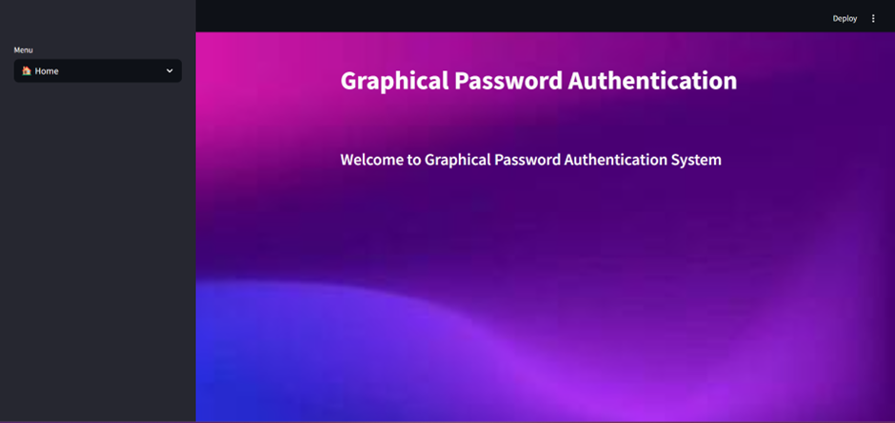
GRAPHICAL PASSWORD AUTHENTICATION
SRI KRISHNA ARTS AND SCIENCE COLLEGE
DEPARTMENT OF COMPUTER TECHNOLOGY & DATA SCIENCE
OUTPUT SCREEN SHORT:

Slide 19
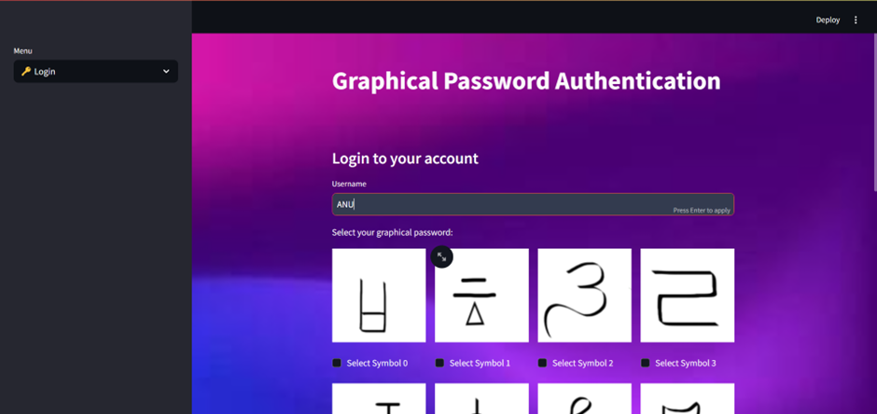
GRAPHICAL PASSWORD AUTHENTICATION
SRI KRISHNA ARTS AND SCIENCE COLLEGE
DEPARTMENT OF COMPUTER TECHNOLOGY & DATA SCIENCE
OUTPUT SCREEN SHORT:

Slide 20
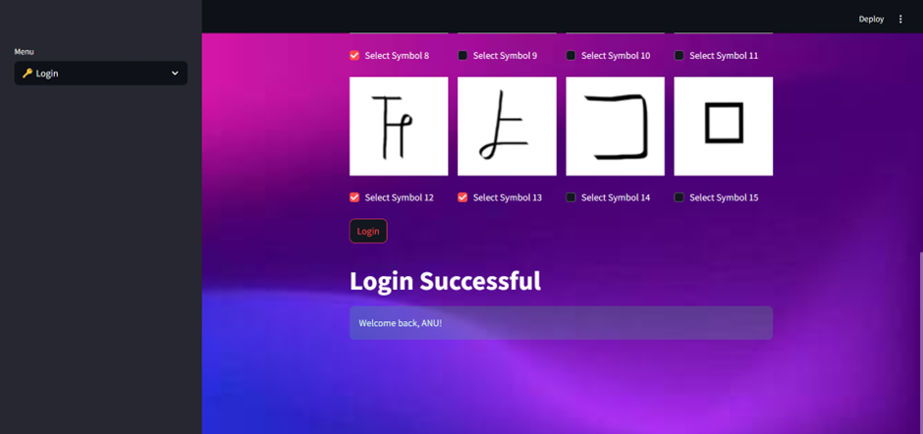
GRAPHICAL PASSWORD AUTHENTICATION
SRI KRISHNA ARTS AND SCIENCE COLLEGE
DEPARTMENT OF COMPUTER TECHNOLOGY & DATA SCIENCE
OUTPUT SCREEN SHORT:

Slide 21
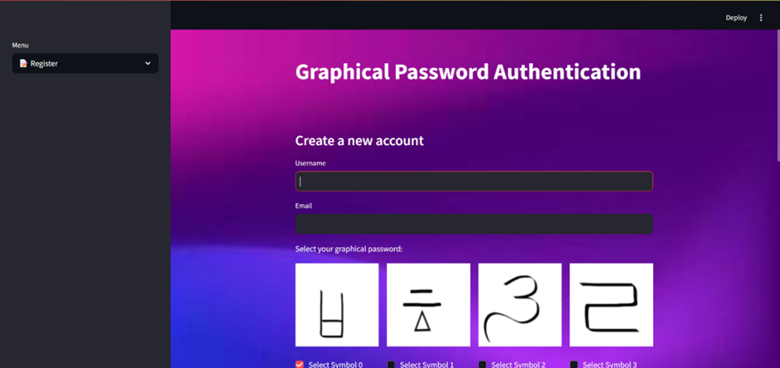
GRAPHICAL PASSWORD AUTHENTICATION
SRI KRISHNA ARTS AND SCIENCE COLLEGE
DEPARTMENT OF COMPUTER TECHNOLOGY & DATA SCIENCE
OUTPUT SCREEN SHORT:

Slide 22
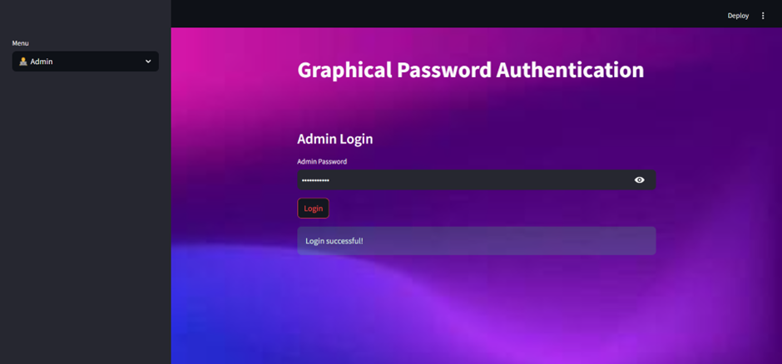
GRAPHICAL PASSWORD AUTHENTICATION
SRI KRISHNA ARTS AND SCIENCE COLLEGE
DEPARTMENT OF COMPUTER TECHNOLOGY & DATA SCIENCE
OUTPUT SCREEN SHORT:

Slide 23
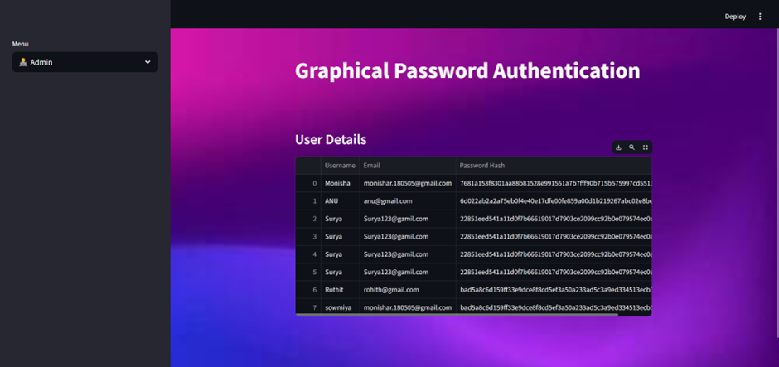
GRAPHICAL PASSWORD AUTHENTICATION
SRI KRISHNA ARTS AND SCIENCE COLLEGE
DEPARTMENT OF COMPUTER TECHNOLOGY & DATA SCIENCE
OUTPUT SCREEN SHORT:

Slide 24
GRAPHICAL PASSWORD AUTHENTICATION
SRI KRISHNA ARTS AND SCIENCE COLLEGE
DEPARTMENT OF COMPUTER TECHNOLOGY & DATA SCIENCE
THANK YOU

